Slide 1
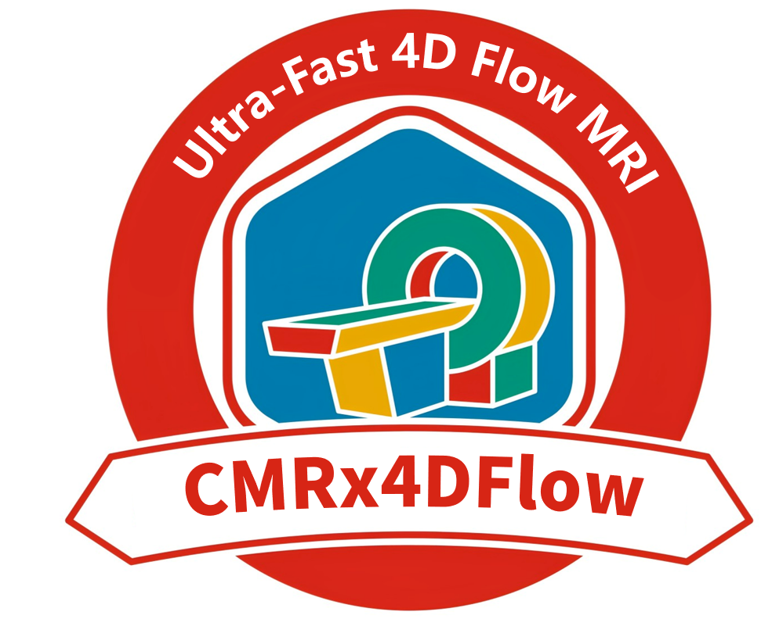
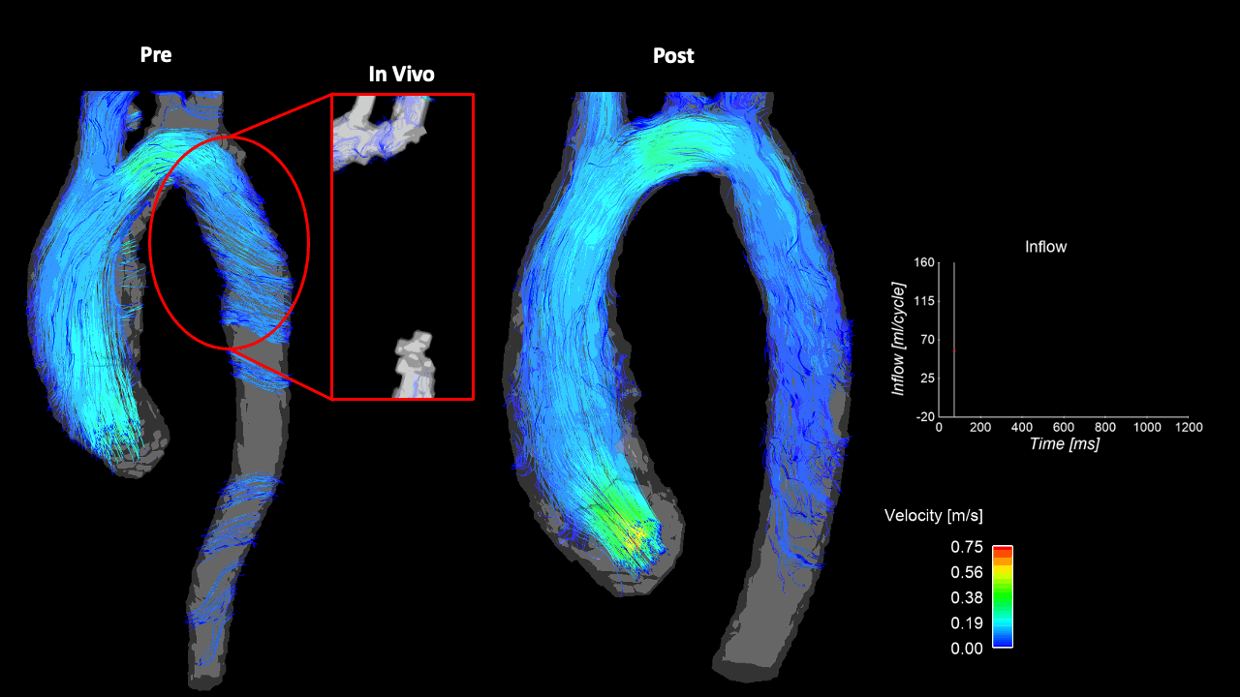
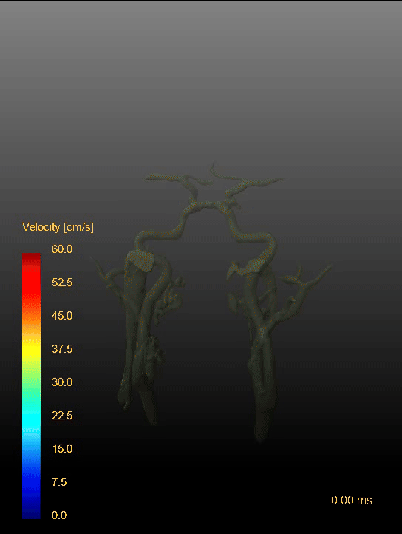
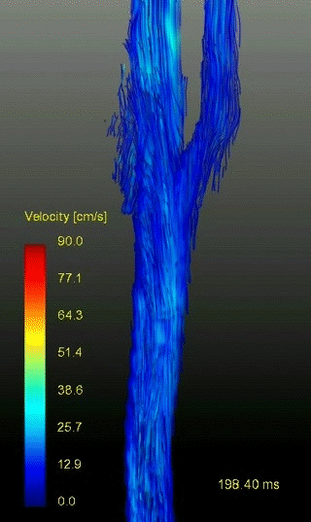
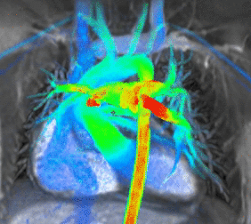
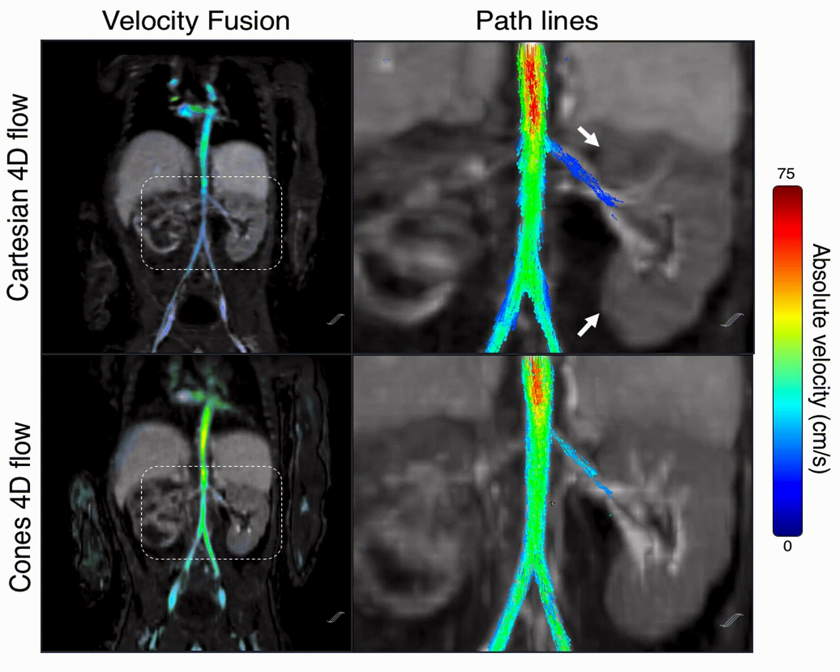



















CMRx4DFlow2026 Challenge: Towards Clinical Adoption of 4D Flow
Goal:
Build the world’s largest standardized 4D Flow raw data collection
Launch a challenge to gather the most outstanding reconstruction methods
Establish an open benchmarking system to promote global algorithm development
Aorta
Intracranial
Data Collection:
Tasks:
Task 1: High quality recon under high acceleration factors (8x–50x)
Task 2: Fast recon under limited computing resources (A6000 48G)
Special Task 1: Generalizability across new sites and diseases
Special Task 2: Generalizability across different anatomical regions
400+ k-space raw datasets:
10+ Centers
4 Vendors
3 Field strength
5 Regions
10+ Pathologies
Carotid
Pulmonary
Portal vein
Renal artery

